Slide 1
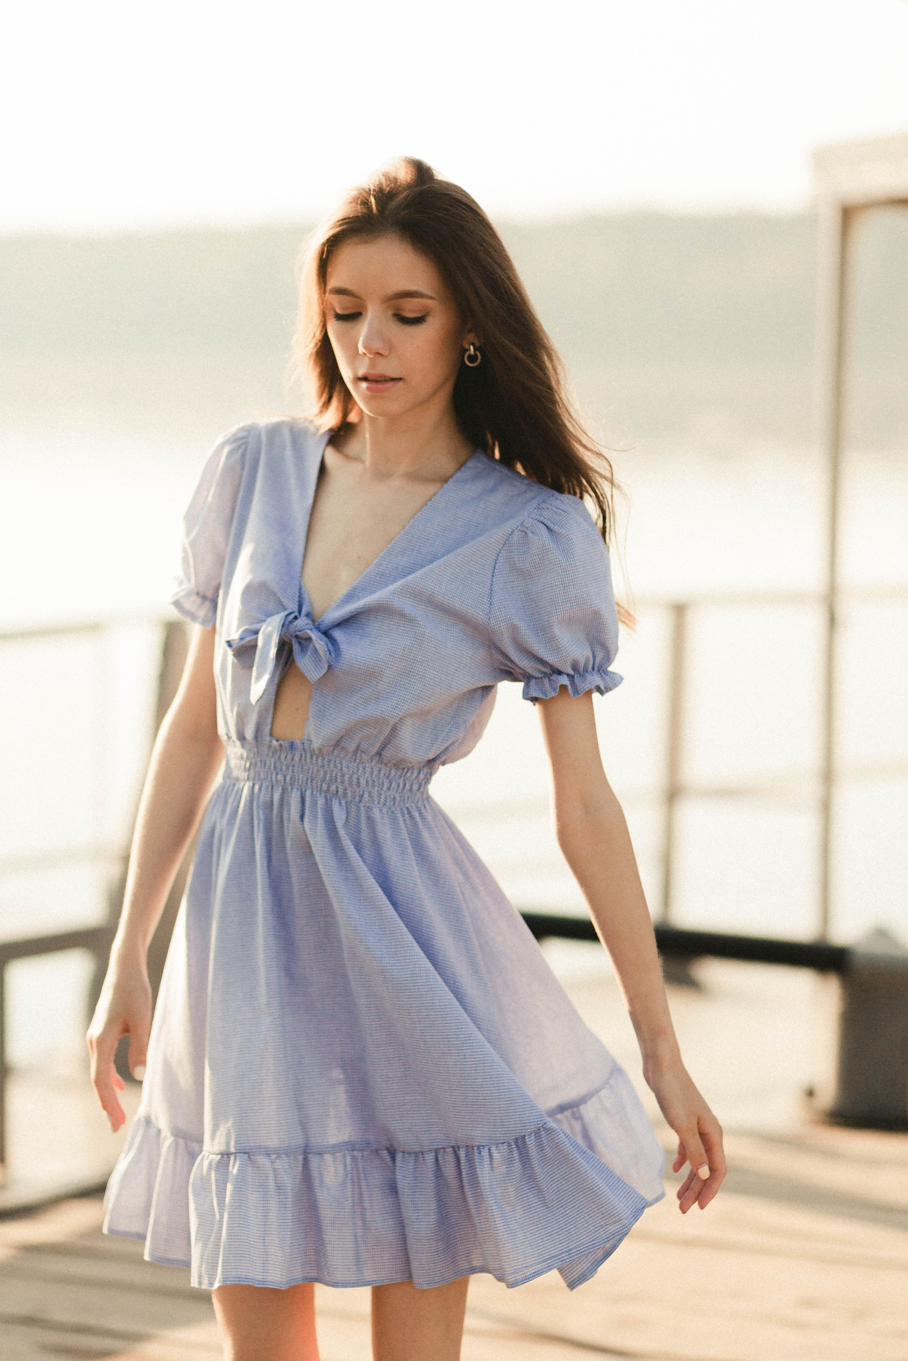

BIRTHDAY
BIRTHDAY
BIRTHDAY
BIRTHDAY
wish you all the best!
keep shining
BIRTHDAY
BIRTHDAY
BIRTHDAY
HAPPY
BIRTHDAY
birthday
BIRTHDAY
Helene Paquet

