Slide 1
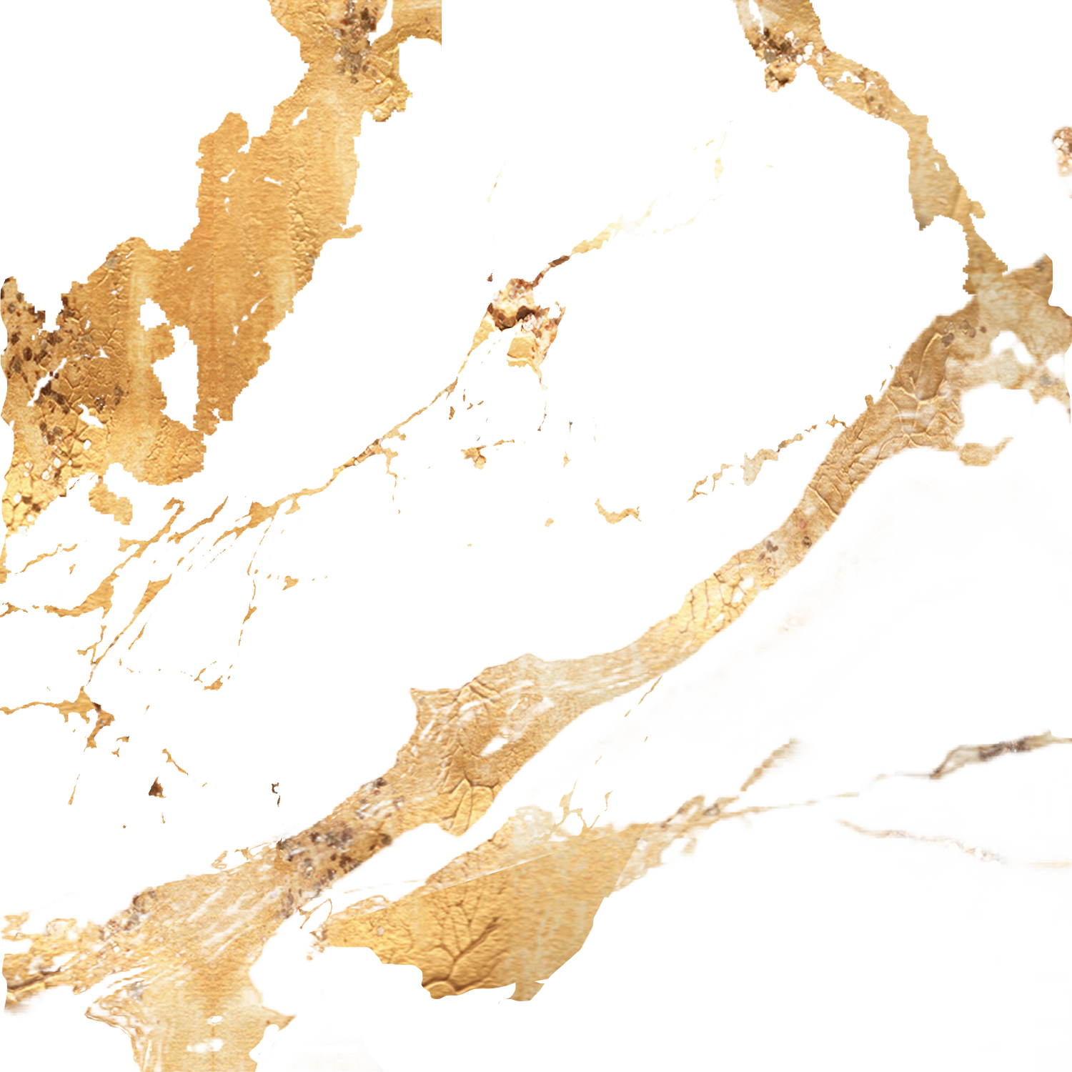
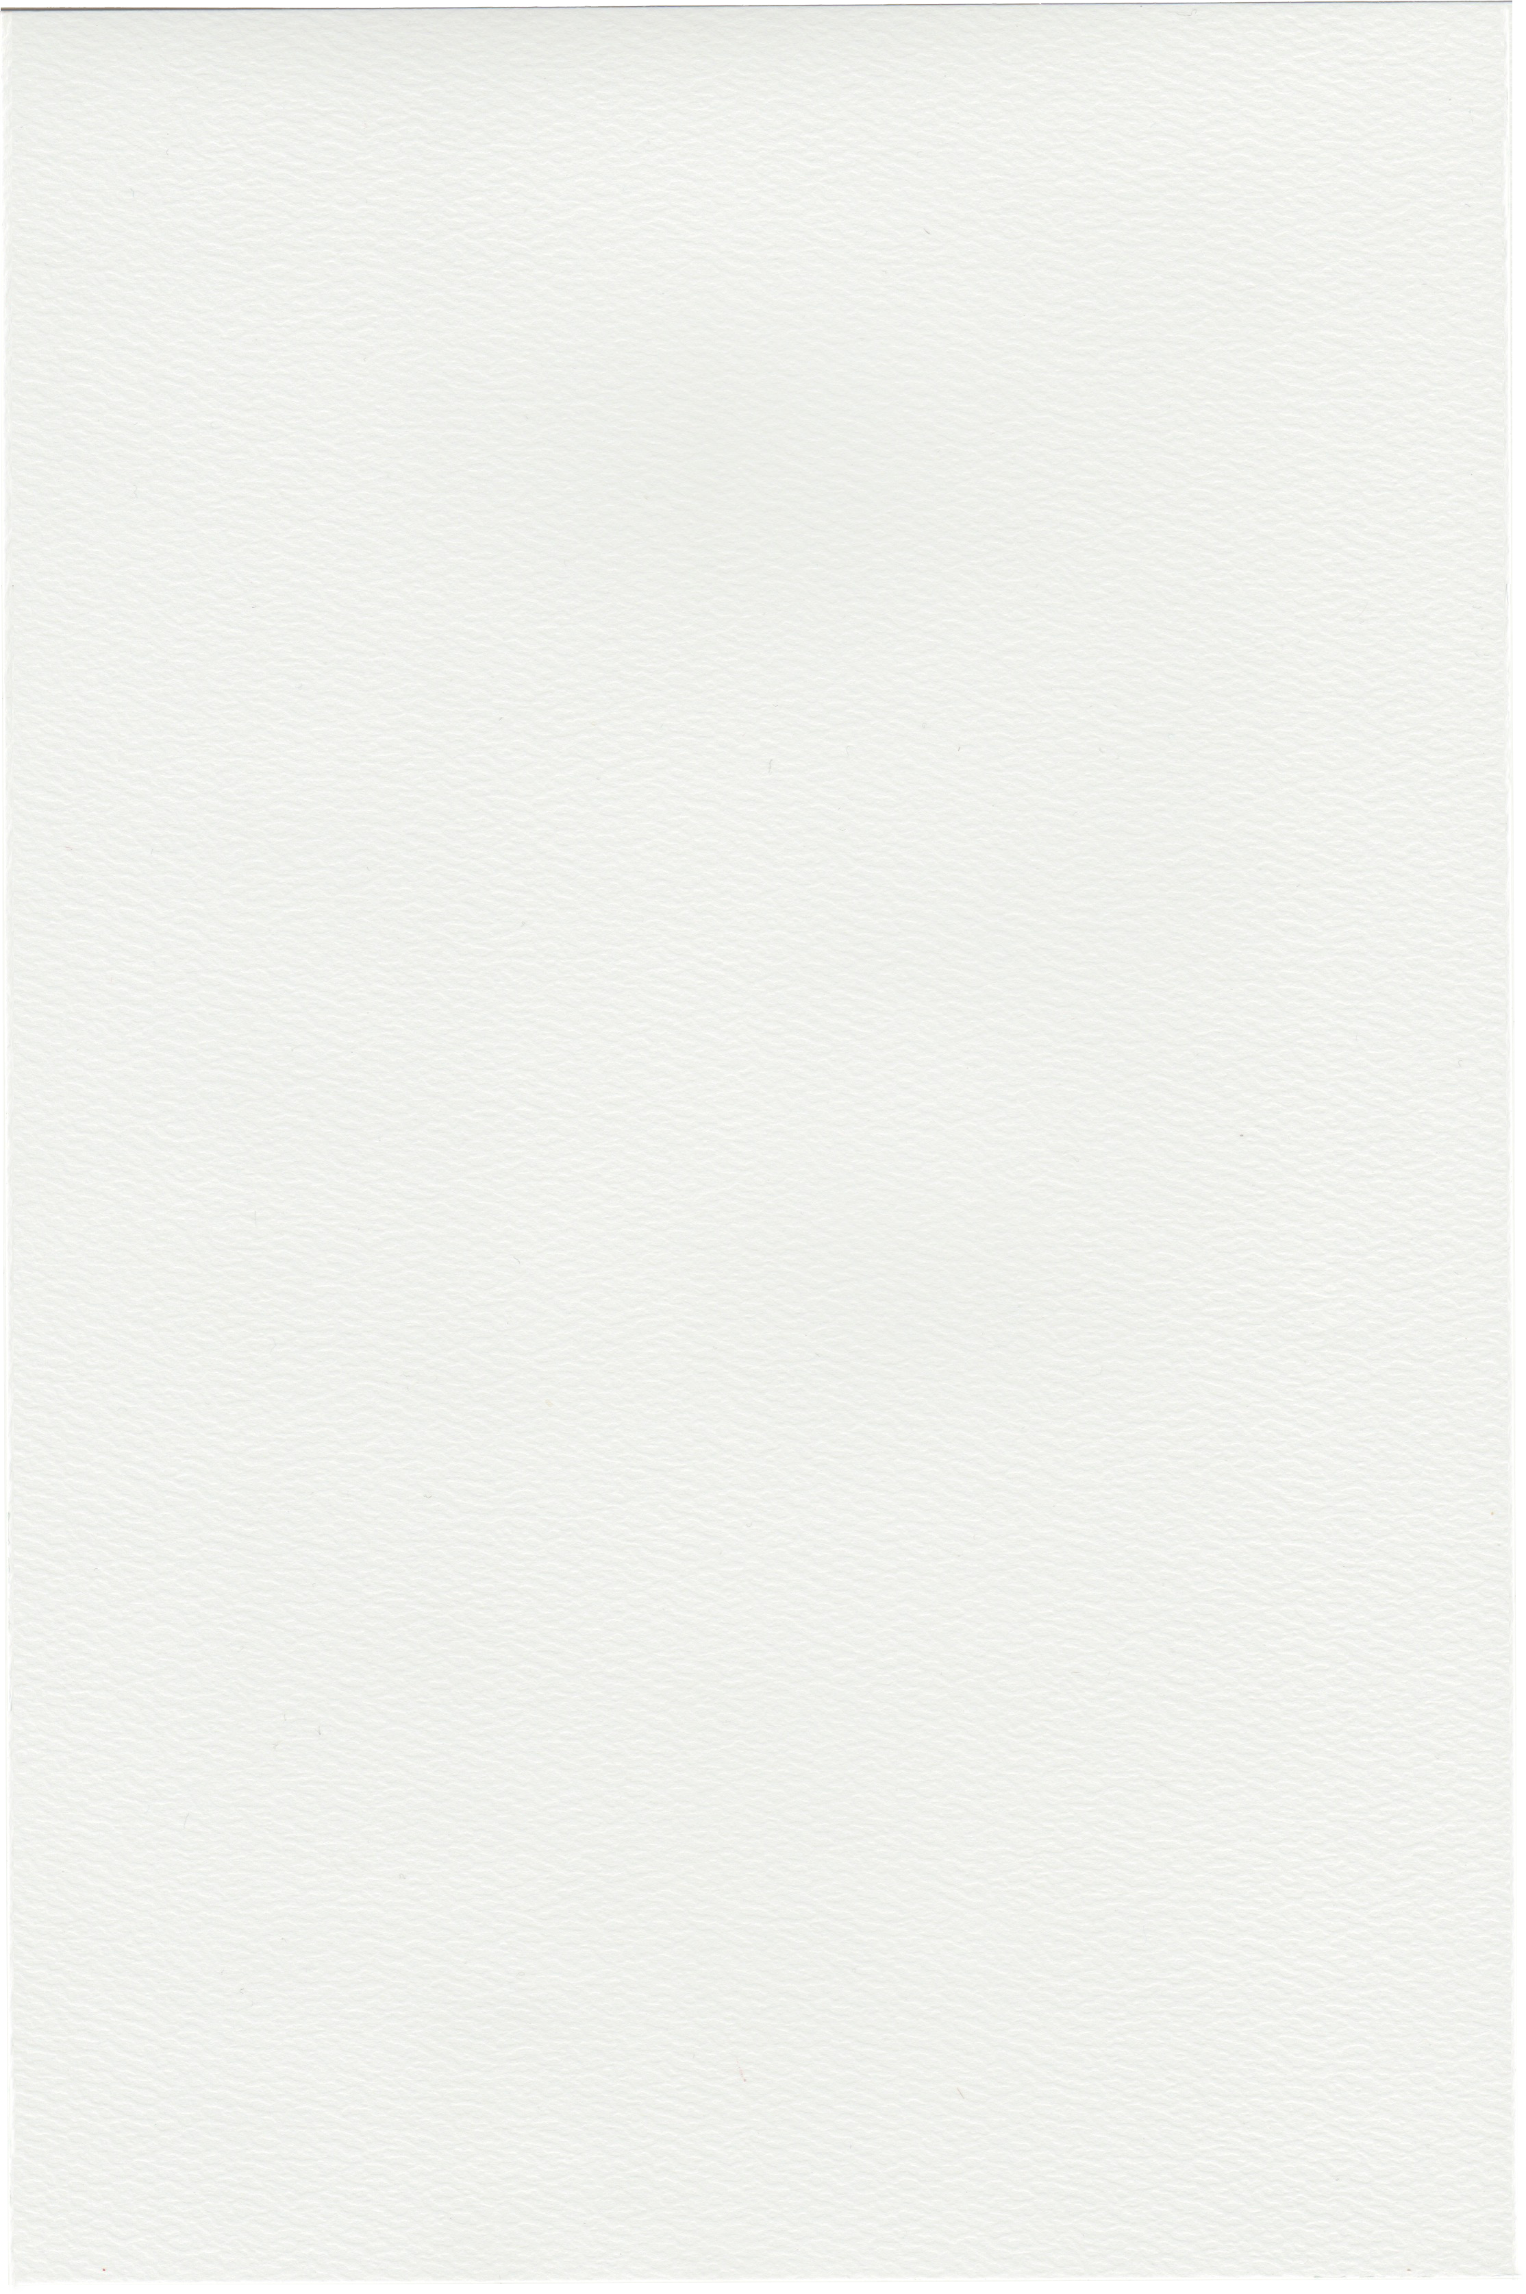
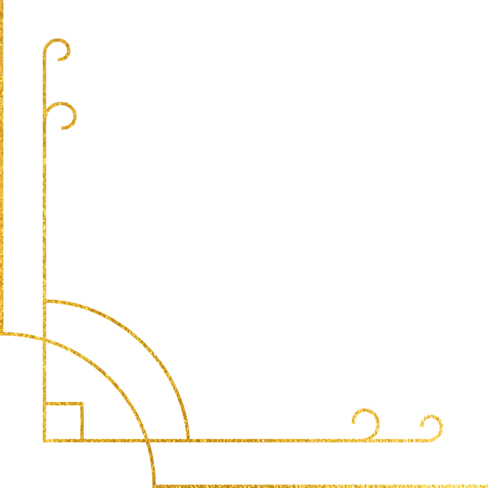
Birthday Party
2025
2025 July 9th, 18:00-21:00
123 Anywhere St., Any City

