Slide 1



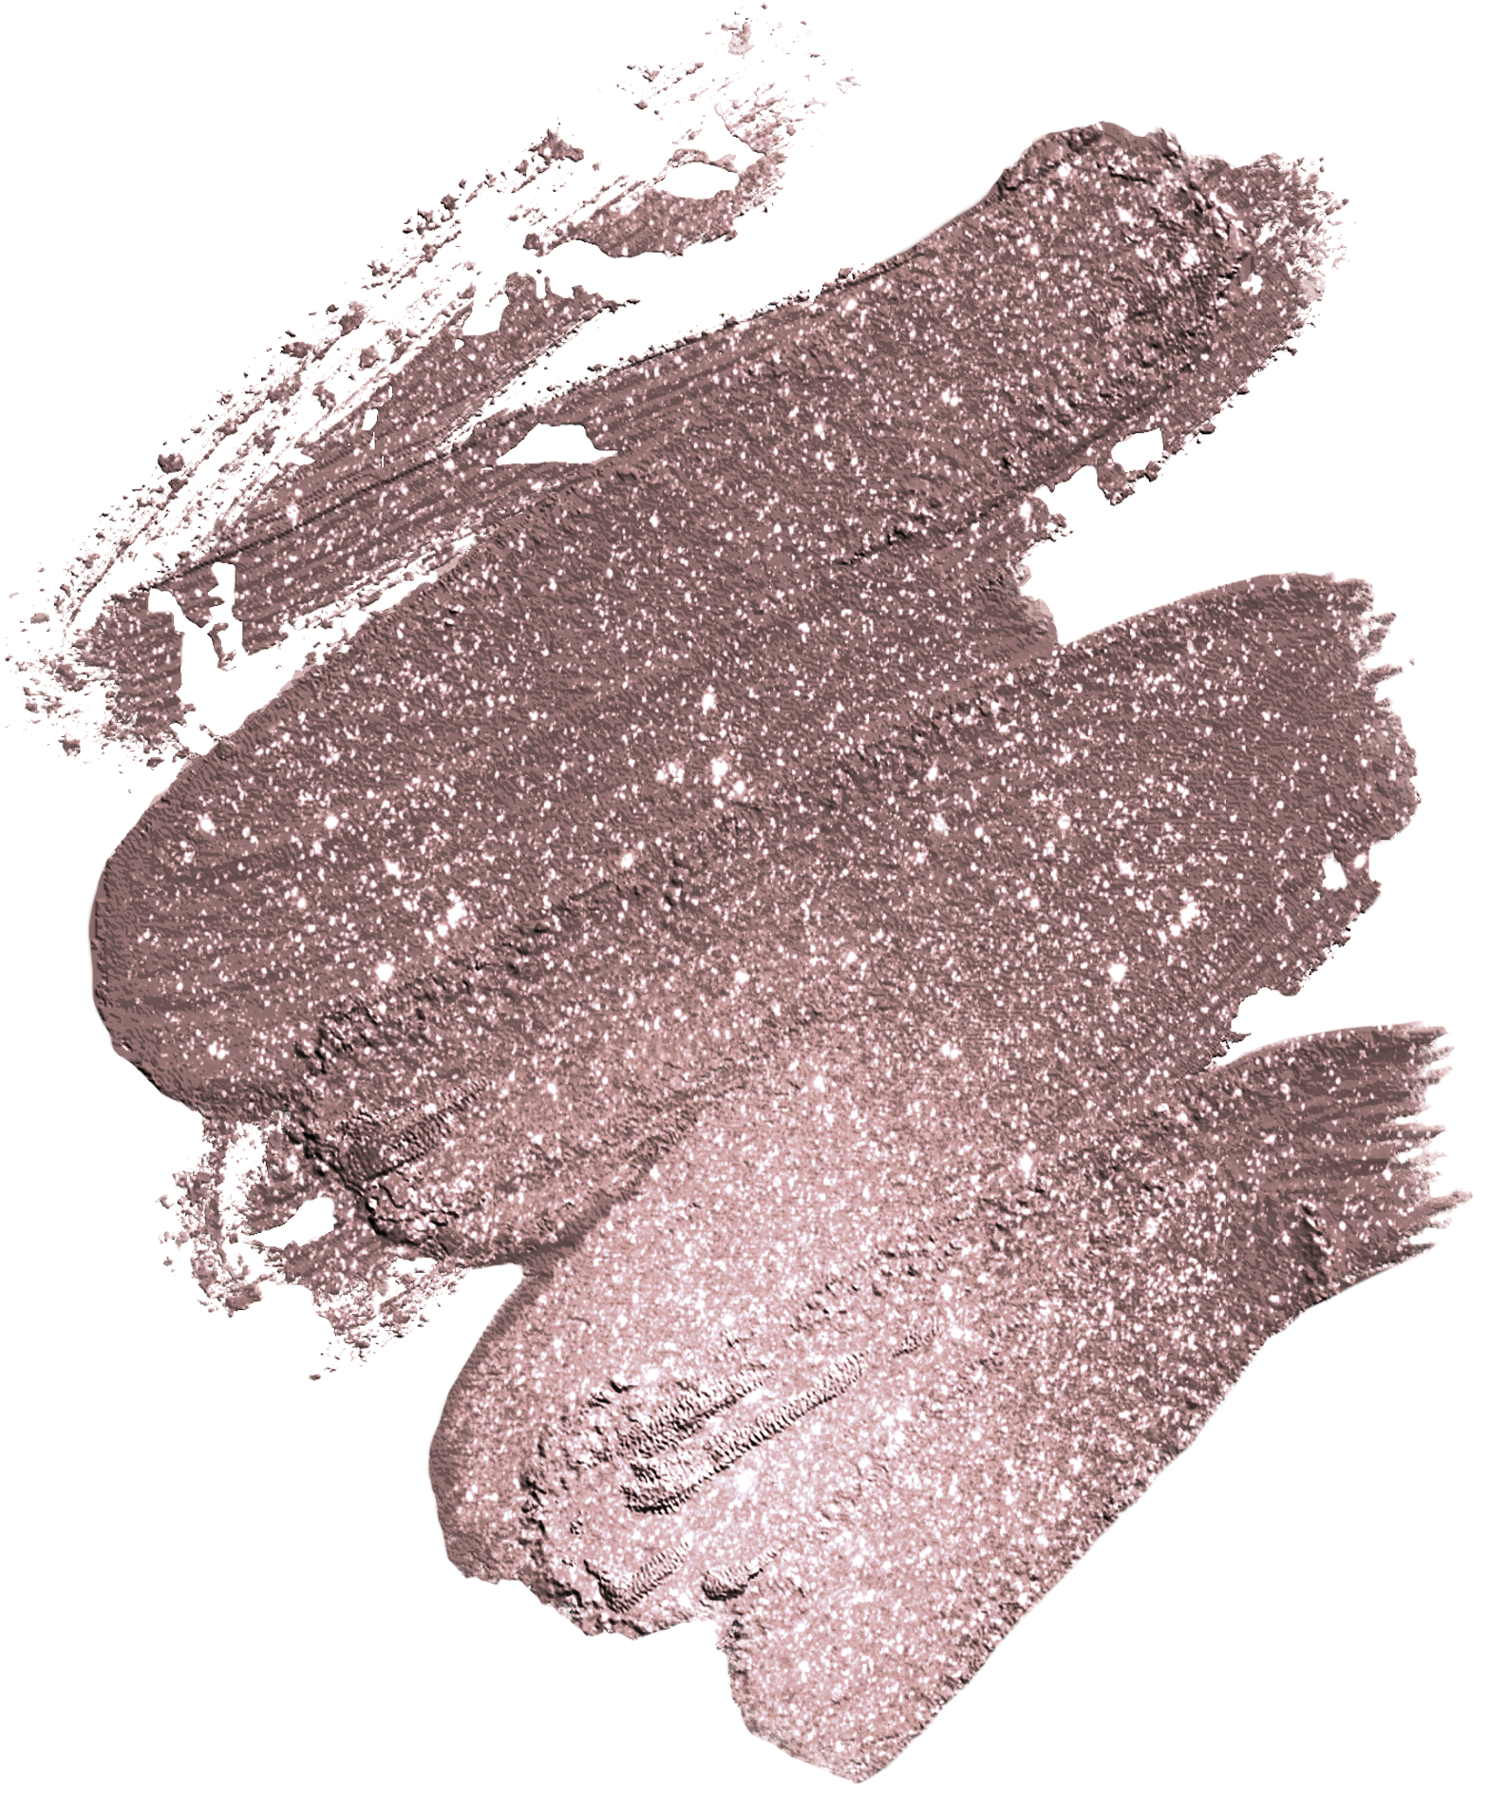
Let's
Party!
Join us to celebrate
Olivia's 7th Birthday
19 October | at 4:00pm
123 Anywhere St., Any City, ST 12345

