Slide 1

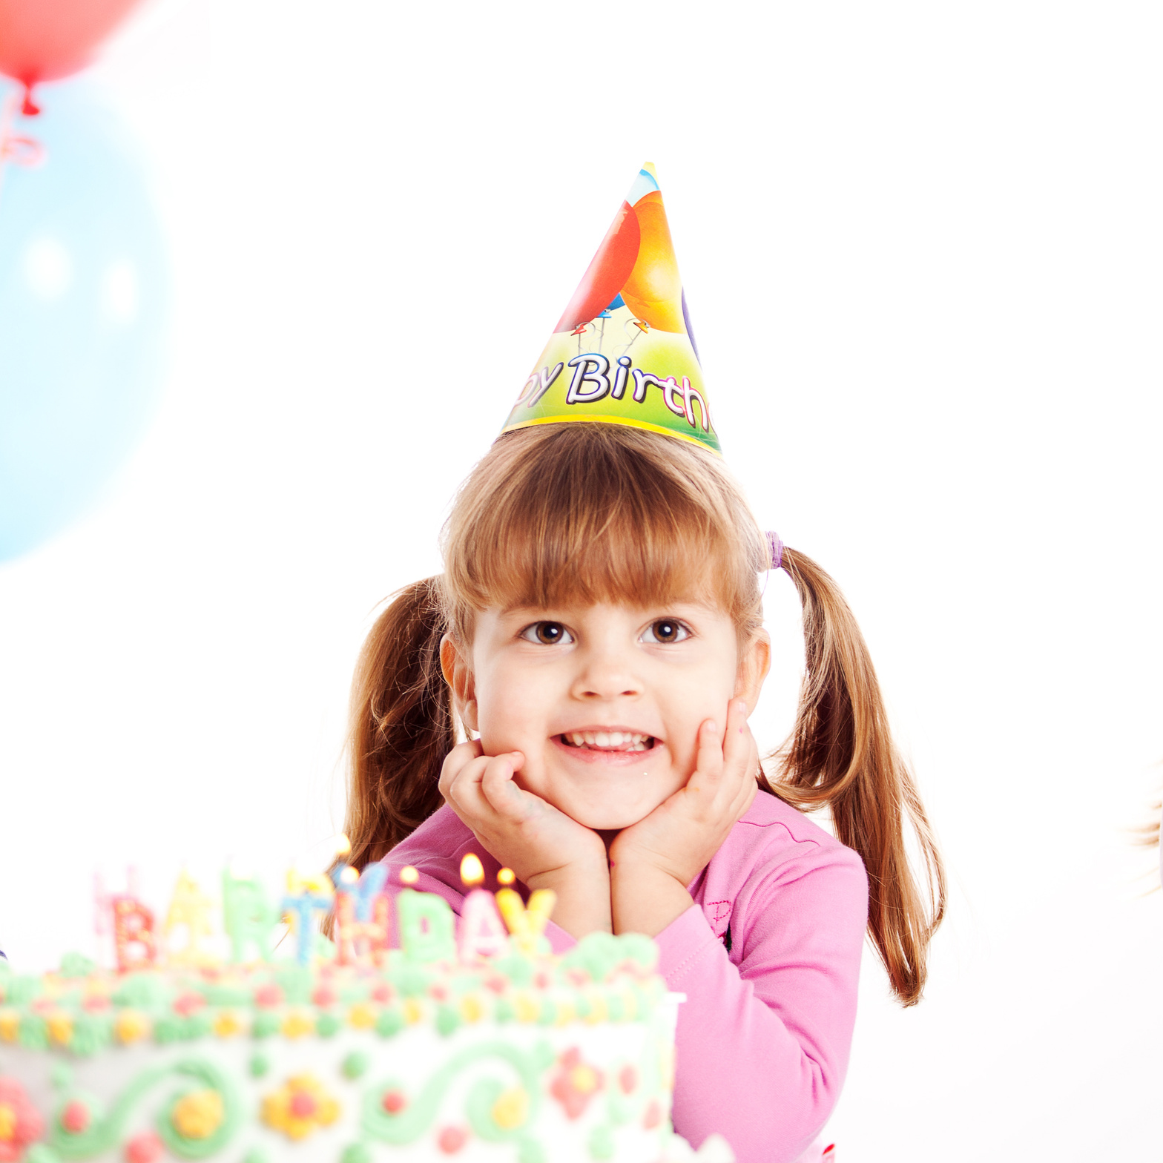

Join Us For A
BIRTHDAY
PARTY
Your presence is requested at the party where we'll celebrate another year of wonderful memories and the promise of more to come.
25 JANUARY, 2030

