Slide 1
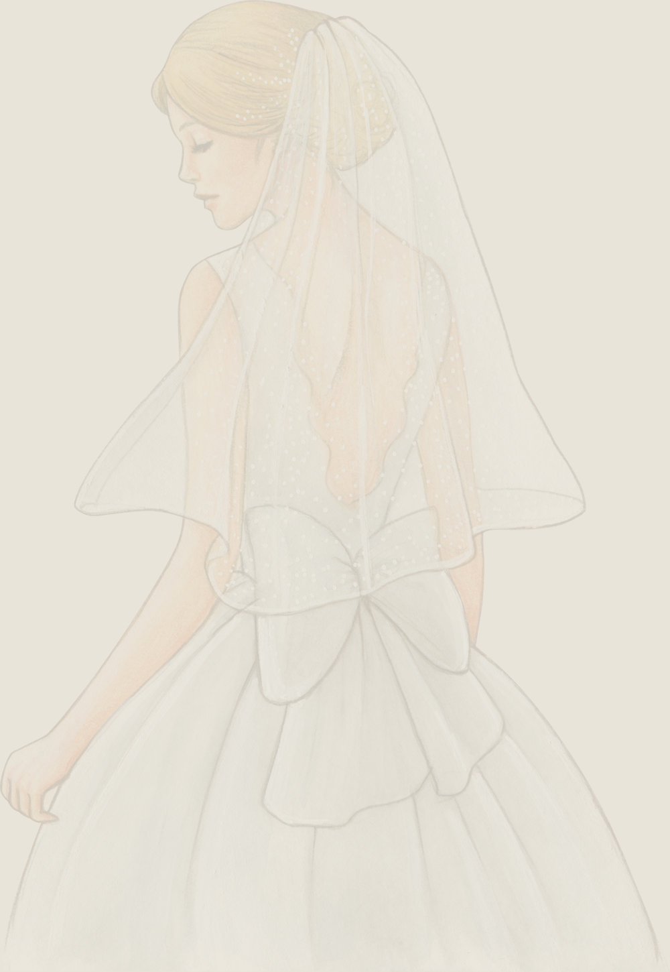

You're Invited
KORINA VILLANUEVA'S
Bridal Shower
June 28th, 2022
3 PM- Done
123 Anywhere St., Any City

