Slide 1


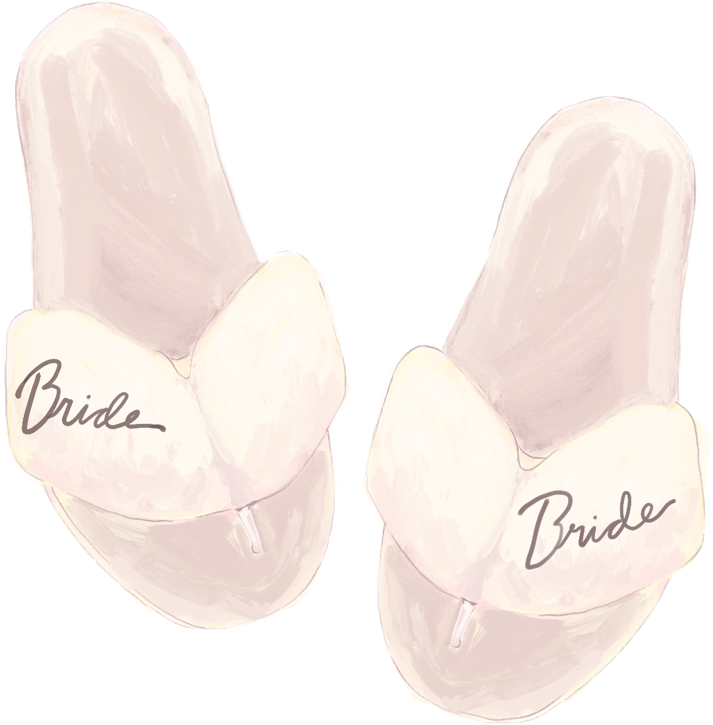

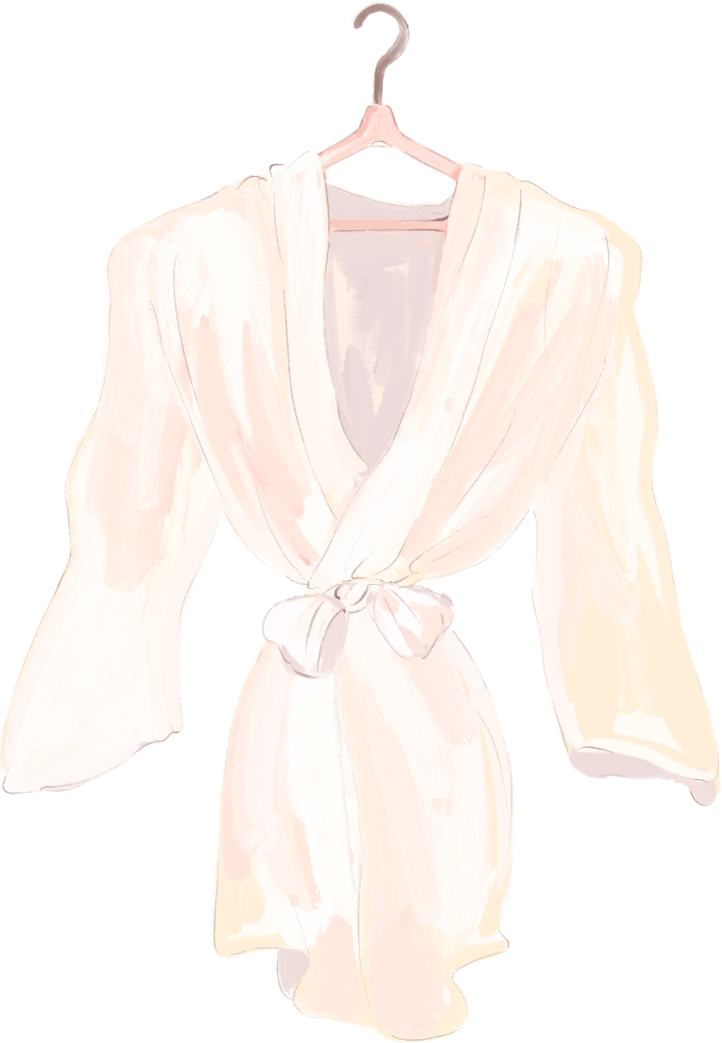


Bride
to be
Saturday, Nov 02
123 Anywhere St., Any City

