Slide 1

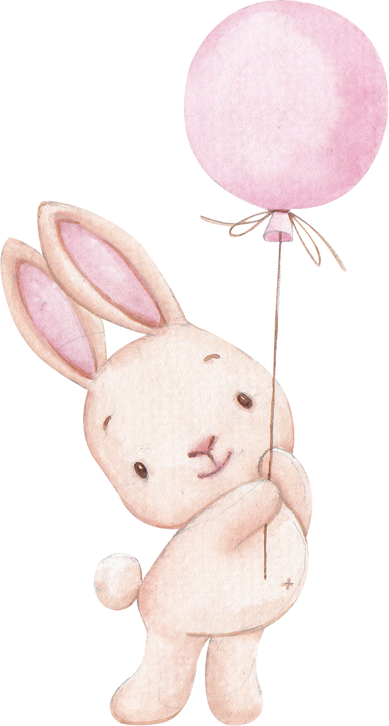




WELCOME TO
Olivia's
Baby Shower
03.19.2024

