Slide 1

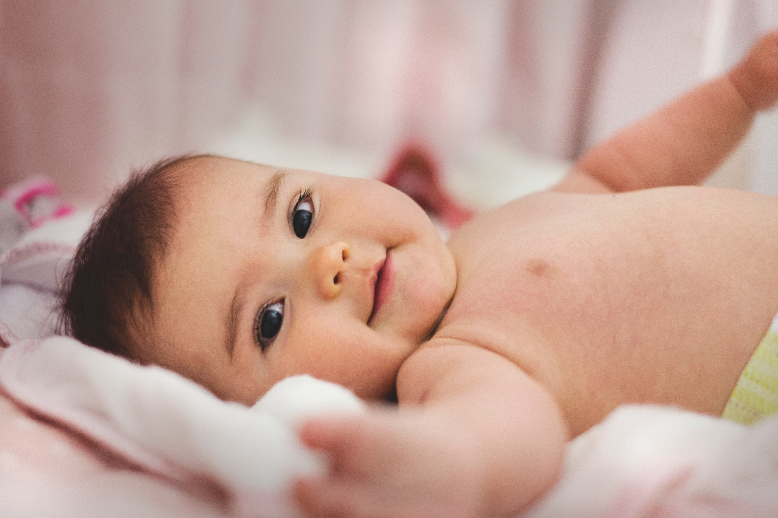

join us for Baby Shower
Baby Shower
Baby Girl : Bailey Dupont
Sunday, 21 December 2023
at residence : Avery Davis
123 Anywhere st., Any City, ST 12345

