Slide 1
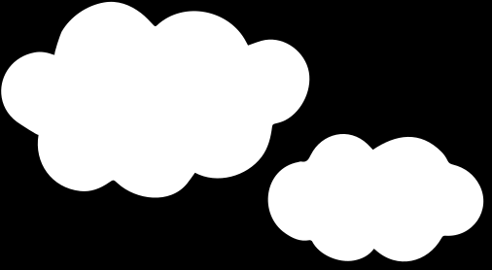
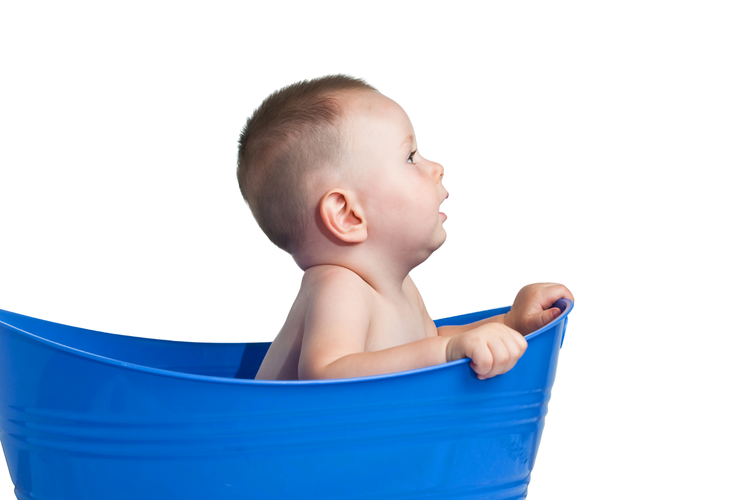
HELLO WORLD
BABY SHOWER
09.02.24 | AT 9PM
123 Anywhere St., Any City

