Slide 1


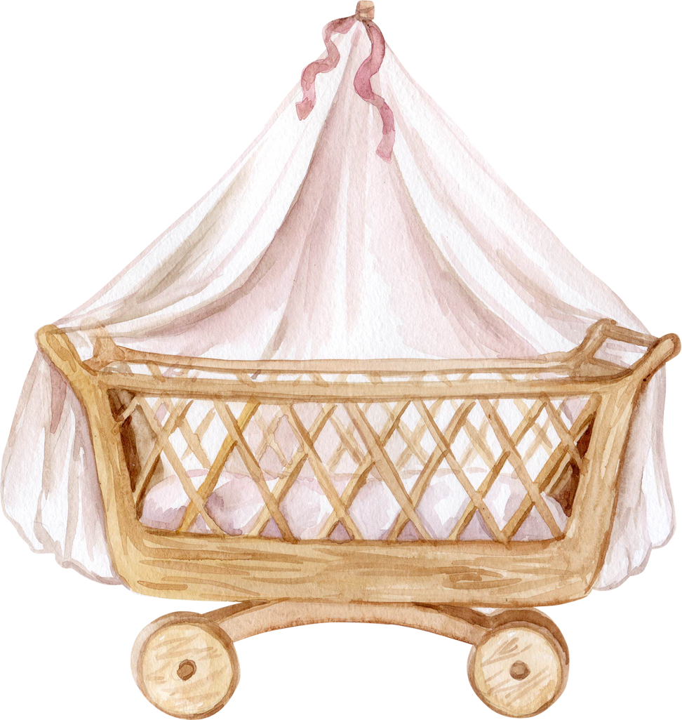
JOIN US FOR A
BABY SHOWER
IN HONOR OF
Sarah James
01.03.2023
ANY WHERE, ANY CITY

