Slide 1
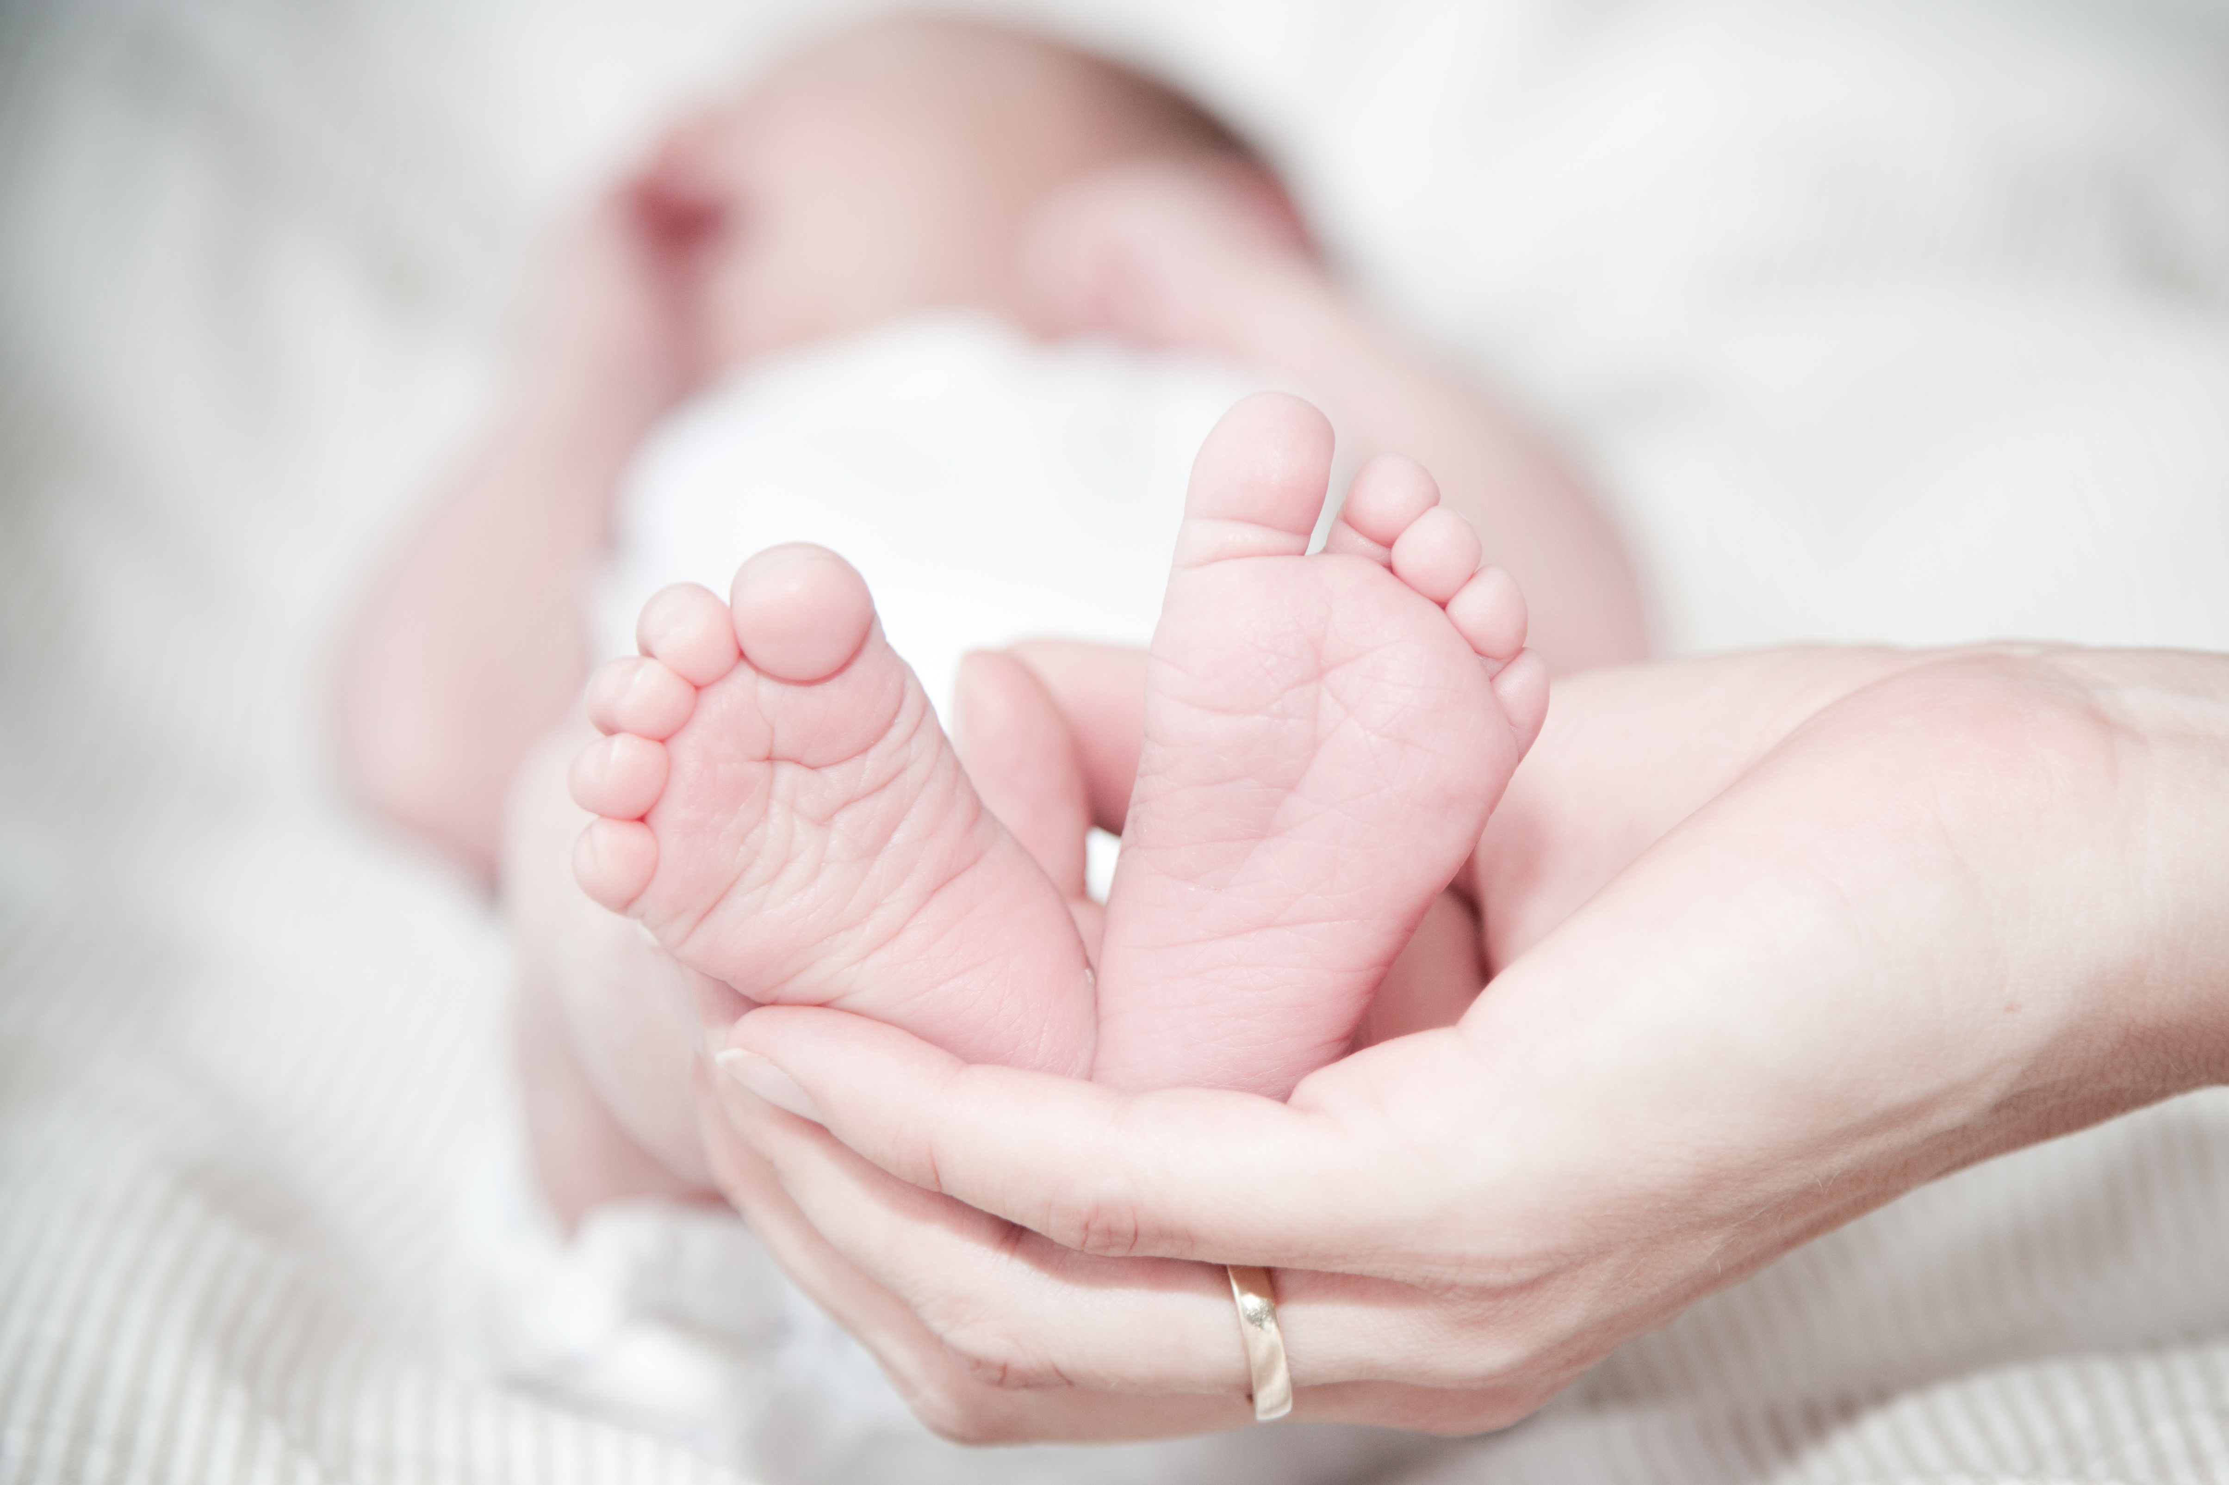
PLEASE JOIN US FOR A
Baby
Shower
CELEBRATING
Margarita Perez
SUNDAY • MAY 17, 2024 • 10:00 PM
123 Anywhere St., Any City, ST 12345

